Slide 1
Mantid
User Interface Discussion
The Mantid Team
05/10/2009

Slide 2
Agenda
Discussion of the groups of users
Suggestions and Picture prototyping of Potential improvements
Prioritisation

Slide 3
Mantid Users - Wants
Visiting users
  Simple, easy to use
  point & click interface?
  Similar on different instruments
Instrument Scientists
  Reliability
Script writers
  Scripting easy to learn
  Powerful tools available
Algorithm Developers
  Speed
  Power
  Control

Slide 4
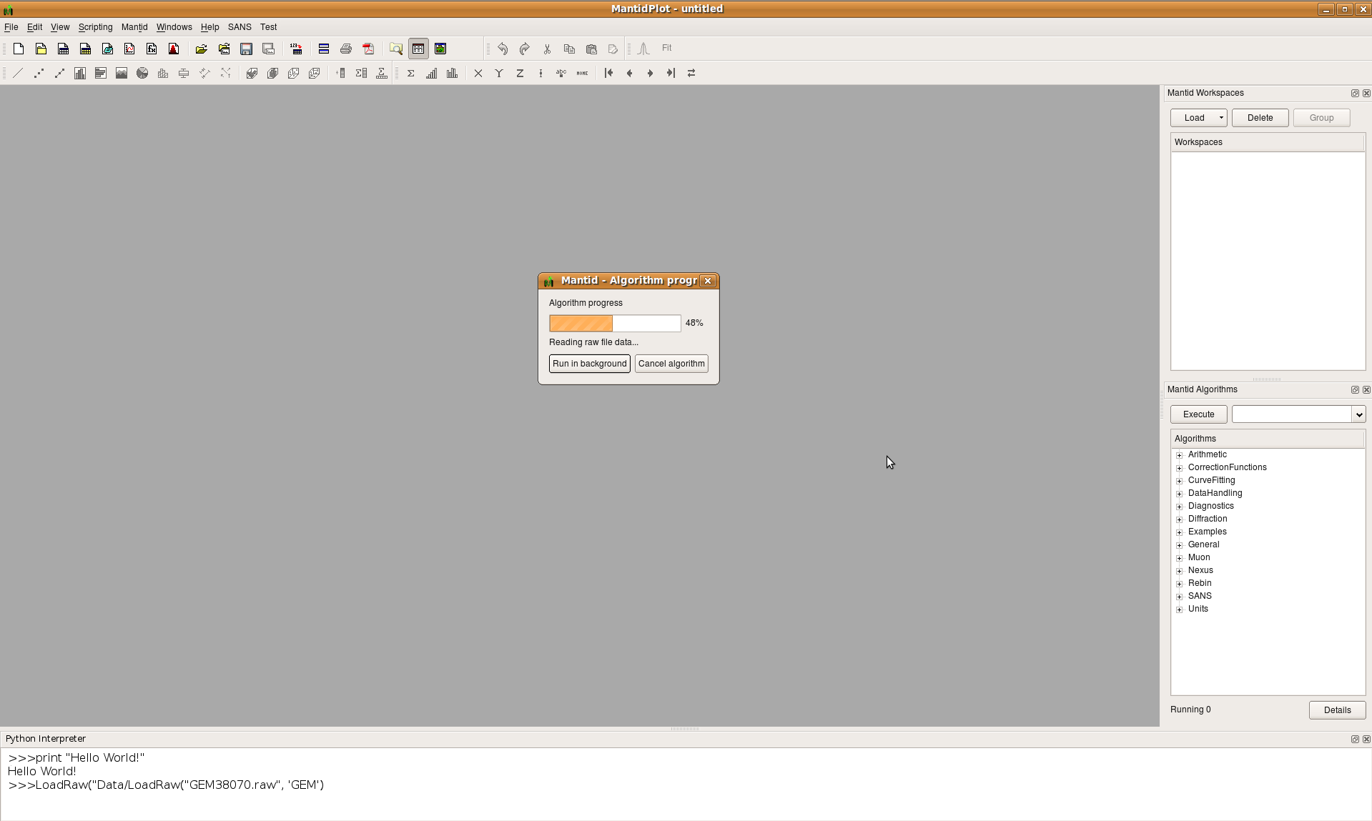
Suggestions of Improvements
Immediate Script Window

Slide 5
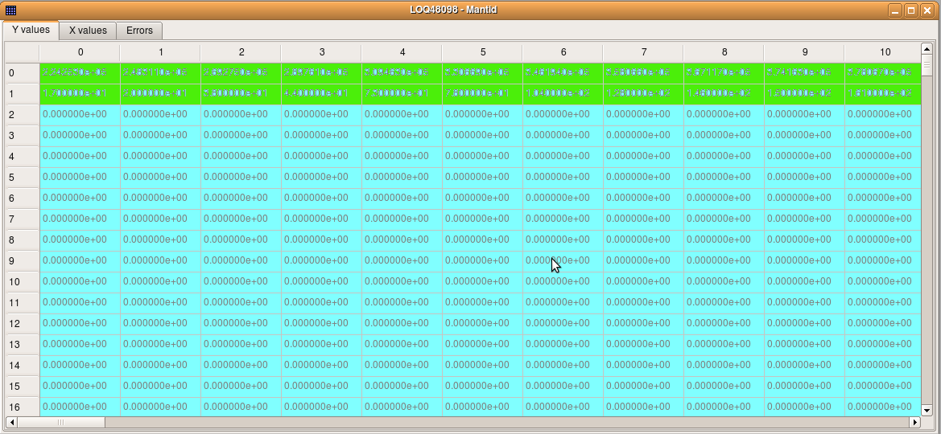
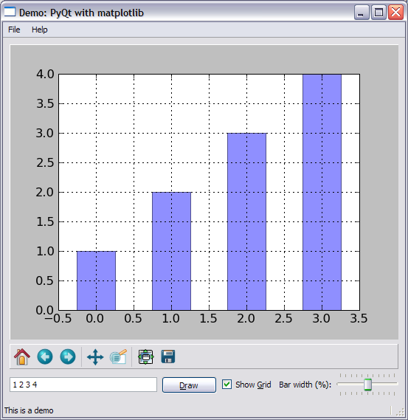
Suggestions of Improvements
Highlight Monitors in Matrix
Integration of MatPlotLib Graphing into MantidPlot?

Slide 6
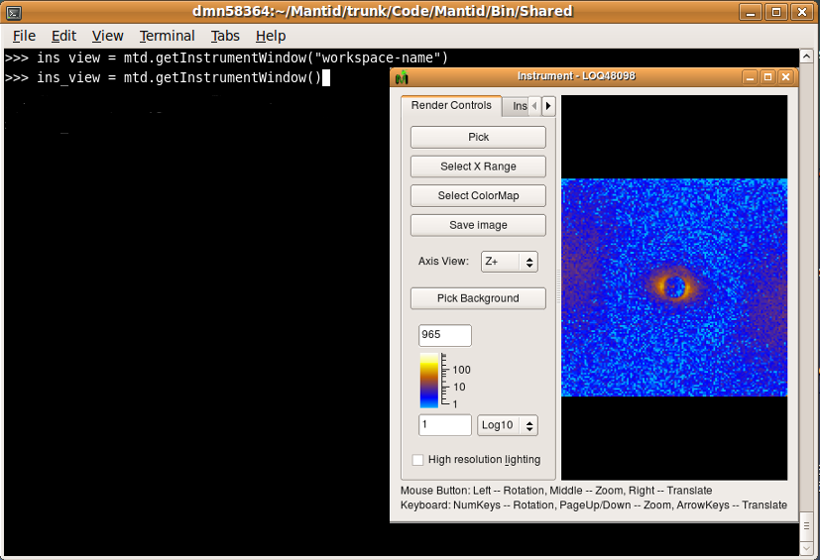
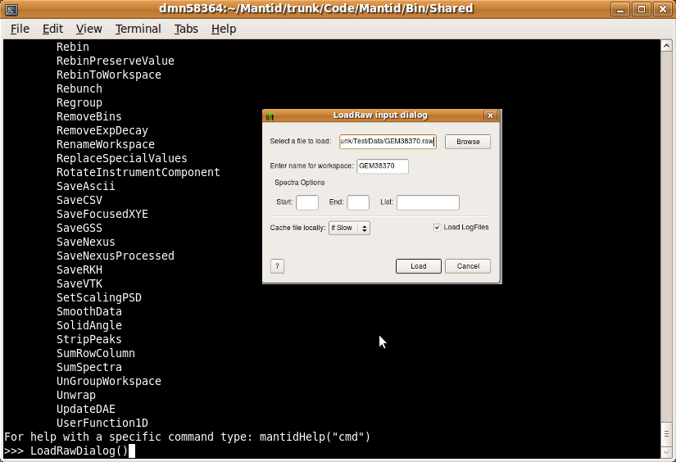
Suggestions of Improvements
Separation of tools from Mantidplot
  Algorithm Dialogs
  Instrument Window
  Also useful for Matlab
  interface

Slide 7
Suggestions for Improvements
Improvements we can acquire from QtiPlot
  Improved Zoom and Pan tool
  Stand alone script window option
Improved integration with MantidPlot menus
  Load data from File\Load
  Save from File\Save
  Integrate into the project save functionality
  Replace Analysis menu tools for Mantid data

Slide 8

Prioritisation

